Slide 1
Theory I: Why Deep Structure?
李宏毅
Hung-yi Lee

Slide 2
Review
1
3
x₁
……
x₁
……
-2
-1
-1
-1
x₂
……
x₂
……
1
1
network structure
Given structure, each set of parameter is a function.
The network structure defines a function set.

Slide 3
Source of image: https://www.aaai.org/ocs/index.php/AAAI/AAAI17/paper/viewPaper/14849

Slide 4
Outline
Q1: Can shallow network fit any function?
Potential of deep
Q2: How to use deep to fit functions?
Q3: Is deep better than shallow?
Review some related theories
NN
Scalar x
Scalar y
[0, 1]
ReLU as activation function

Slide 5

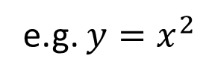

Outline
Notice: We do not discuss optimization and generation today.
3
What is the difference?
small
median
large
2
Deep
$$\hat{θ}$$
Small?
1
Shallow
A target function to fit
Eventually cover $\hat{θ}$?
e.g. $y=x^{2}$

Slide 6
Can shallow network fit any function?
Notes:
Should I mention “memory” network?
https://www.slideshare.net/pfi/deep-learning-practice-and-theory
P62
Two layer network is memory.

Slide 7




Universality
Given a shallow network structure with one hidden layer with ReLU activation and linear output
Given a L-Lipschitz function $f^{∗}$
How many neurons are needed to approximate $f^{∗}$?
+
$$f$$
$$x$$
1
……
+
$$y$$
A piece-wise linear functions
1
+
1

Slide 8


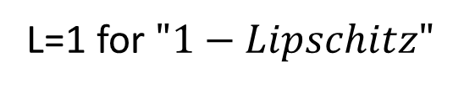


Universality
Given a L-Lipschitz function $f^{∗}$
How many neurons are needed to approximate $f^{∗}$?
L-Lipschitz Function
(smooth)
$\text{1−}\text{Lipschitz}?$
$$\left\|f\left(x_{1}\right)−f\left(x_{2}\right)\right\|≤L\left\|x_{1}−x_{2}\right\|$$
Output change
Input
change
$\text{1−}\text{Lipschitz}?$
L=1 for $"1−Lipschitz"$

Slide 9



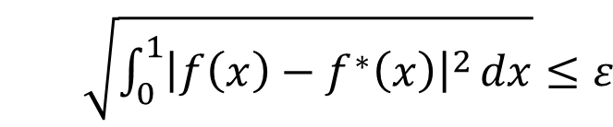
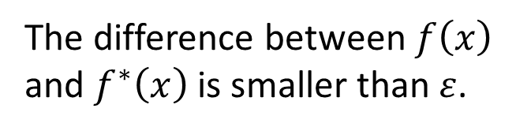

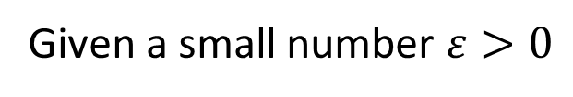

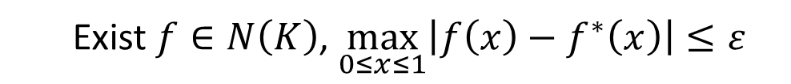

Universality
$\max_{0≤x≤1}\left|{f\left(x\right)−f}^{∗}\left(x\right)\right|≤ε$
$\sqrt{\int_{0}^{1}{{\left|{f\left(x\right)−f}^{∗}\left(x\right)\right|}^{2}}dx}{≤ε}$
Given a L-Lipschitz function $f^{∗}$
How many neurons are needed to approximate $f^{∗}$?
The function space defined by the network with K neurons.
$$f∈N\left(K\right)$$
Given a small number $ε>0$
What is the number of $K$ such that
Exist $f∈N\left(K\right)$, $\max_{0≤x≤1}\left|{f\left(x\right)−f}^{∗}\left(x\right)\right|≤ε$
$f\left(x\right)$
The difference between $f\left(x\right)$ and $f^{∗}\left(x\right)$ is smaller than $ε$.
$$≤ε$$
$f^{∗}\left(x\right)$

Slide 10







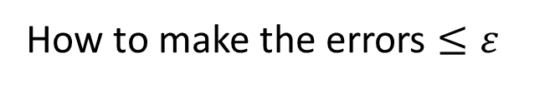

Universality
All the functions in $N\left(K\right)$ are piecewise linear.
Approximate $f^{∗}$ by a piecewise linear function f
L-Lipschitz function $f^{∗}$
How to make the errors $≤ε$
$$l×L≤ε$$
$$l≤ε/L$$
error
$$≤l×L$$
error
$$l$$
0
1
$$\left\|f\left(x_{1}\right)−f\left(x_{2}\right)\right\|≤L\left\|x_{1}−x_{2}\right\|$$

Slide 11
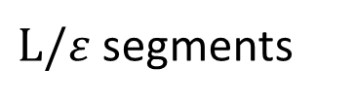



Universality
How to make a 1 hidden layer relu network have the output like green curve?
L-Lipschitz function $f^{∗}$
$L/ε$ segments
0
$$ε/L$$
$$ε/L$$
$$ε/L$$
1

Slide 12
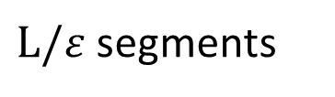
$L/ε$ segments
The summation of the blue functions is the green one.
two relu neurons
bias
0
1
Each blue function can be obtained by two relu neurons.

Slide 13


2
1
1
+
2
1/3
2/3
1
2
9
+
1
-3
$$x$$
1
……
+
$$y$$
0
1
+
2
9
-1
1
+
-6
2
1

Slide 14
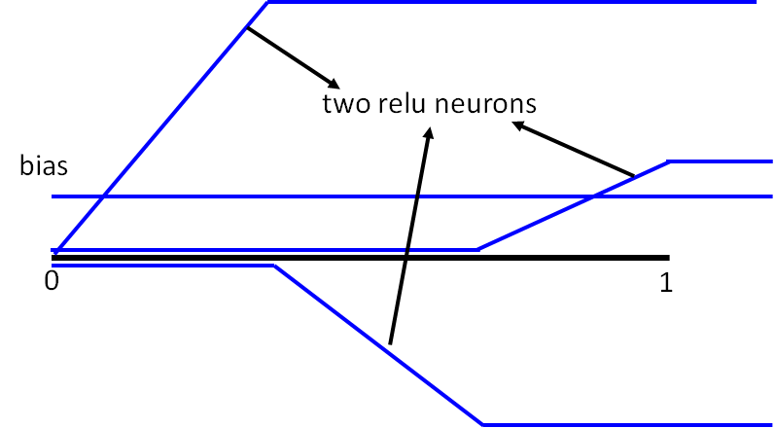


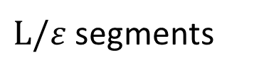


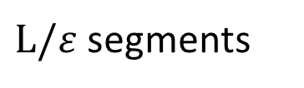





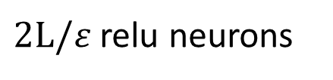


$L/ε$ segments
$$y_{1}$$
$$y$$
$$y_{3}$$
$$y_{0}$$
$$y_{2}$$
$$=$$
+
$L/ε$ segments
+
$$y_{1}$$
$2L/ε$ relu neurons
+
1
$$x$$
+
$$y$$
+
$$y_{0}$$
+
$$y_{2}$$
1
+
1
(I do not say this is the most efficient way to use the neurons.)
……

Slide 15

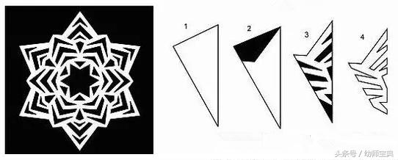
Potential of deep

Slide 16


Why we need deep?
+
$$x$$
1
……
+
$$y$$
1
+
1
Yes, shallow network can represent any function.
However, using deep structure is more effective.

Slide 17

Analogy ─ Programming
Solve any problem by two lines (shallow)
Input = K
Line 1: row no. = MATCH_KEY(K)
Line 2: Output the value at row no.
Considering SVM with kernel
Using multiple steps to solve problems is more efficient (deep)
Input (key) | Output (value)
A | A’
B | B’
C | C’
D | D’
…… | ……
$$y=\sum_{n}{α_{n}K\left(x^{n},x\right)}$$

Slide 18
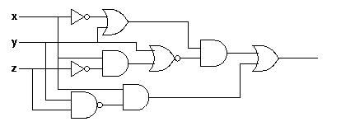
Analogy
Logic circuits
Neural network
Logic circuits consists of gates
A two layers of logic gates can represent any Boolean function.
Using multiple layers of logic gates to build some functions are much simpler
Neural network consists of neurons
A hidden layer network can represent any continuous function.
Using multiple layers of neurons to represent some functions are much simpler
less gates needed
less neurons
This page is for EE background.

Slide 19
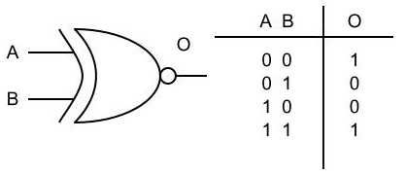
Analogy
E.g. parity check
Circuit
For input sequence with d bits,
1 0 1 0
1 (even)
Circuit
Two-layer circuit need O(2^{d}) gates.
0 0 0 1
0 (odd)
XNOR
1
0
0
1
0
1
0
With multiple layers, we need only O(d) gates.
Notes:
Any Boolean function can be written as a sum of products (disjunctive normal form: AND gates on the first layer with optional negation of inputs, and OR gate on the second layer) or a product of sums (conjunctive normal form: OR gates on the first layer with optional negation of inputs, and AND gate on the second layer).
同位元檢查(Parity Check)
00 1
01 0
10 0
11 1

Slide 20

Why we need deep?
ReLU networks can represent piecewise linear functions
$$≈$$
Shallow & wide
the same number of parameters
Deep & Narrow
Less pieces
More pieces

Slide 21
Upper Bound of Linear Pieces
0
0
0
Upper Bound
0
Each “activation pattern” defines a linear function.
N neurons
2^{N} “activation patterns”
2^{N} “linear pieces”

Slide 22


Upper Bound of Linear Pieces
Not all the “activation patterns” available
1
+
1
1
$$x$$
1
+
$$y$$
0
1
1
1
+
-1
1
In shallow network, each neuron only provides one linear piece.
-1
1

Slide 23













Abs Activation Function
$$wx+b$$
$$w$$
+
$$b$$
$$1$$
$$w$$
$$x$$
+
1
$$x$$
+
$$b$$
$$\left|wx+b\right|$$
1
$$−w$$
$$1$$
Use two relu to implement an abs activation function
+
$$−b$$
1
$$−wx−b$$

Slide 24















2¹ lines
2² lines
$$x$$
+
$$a_{1}$$
+
$$a_{2}$$
1
1
$$0$$
$$0$$
$$0$$
$$x$$
$$a_{1}$$
$$x$$
$$1$$
$$1$$
$$1$$
$$a_{1}$$
$$a_{2}$$
$$a_{2}$$

Slide 25













Each node added
The regions are twice.
2¹ lines
2² lines
2³ lines
$$x$$
+
$$a_{1}$$
+
$$a_{2}$$
+
$$a_{3}$$
1
1
1
$$0$$
$$0$$
$$0$$
$$x$$
$$a_{2}$$
$$x$$
$$1$$
$$1$$
$$1$$
$$a_{2}$$
$$a_{3}$$
$$a_{3}$$

Slide 26









Shallow
+
+1 line
+
$$y_{1}$$
+
1
$$x$$
+
$$y$$
+
$$y_{0}$$
+
$$y_{2}$$
1
+
+1 line
1
Deep
……
2¹ lines
2² lines
2³ lines
$$x$$
+
$$a_{1}$$
+
$$a_{2}$$
+
$$a_{3}$$
2 relu
2 relu
2 relu
1
1
1

Slide 27
Lower Bound of Linear Pieces
If K is width, H is depth
We can have at least K^{H} pieces
Depth has much larger influence than depth.
Razvan Pascanu, Guido Montufar, Yoshua Bengio, “On the number of response regions of deep feed forward networks with piece-wise linear activations”, ICLR, 2014
Guido F. Montufar, Razvan Pascanu, Kyunghyun Cho, Yoshua Bengio, “On the Number of Linear Regions of Deep Neural Networks”, NIPS, 2014
Raman Arora, Amitabh Basu, Poorya Mianjy, Anirbit Mukherjee, “Understanding Deep Neural Networks with Rectified Linear Units”, ICLR 2018
Thiago Serra, Christian Tjandraatmadja, Srikumar Ramalingam, “Bounding and Counting Linear Regions of Deep Neural Networks”, arXiv, 2017
Maithra Raghu, Ben Poole, Jon Kleinberg, Surya Ganguli, Jascha Sohl-Dickstein, On the Expressive Power of Deep Neural Networks, ICML, 2017

Slide 28
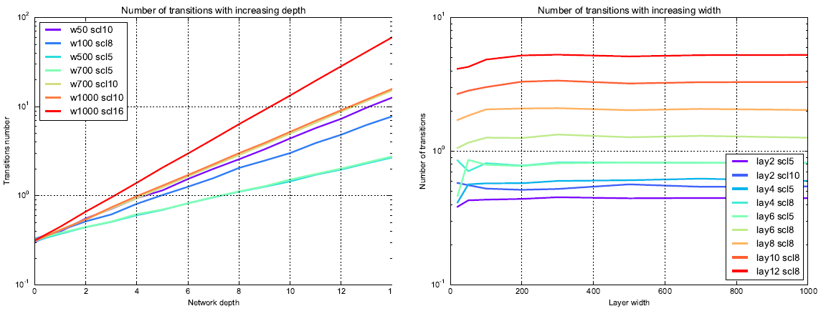
Experimental Results
(MNIST)

Slide 30
How much is deep better than shallow?

Slide 31
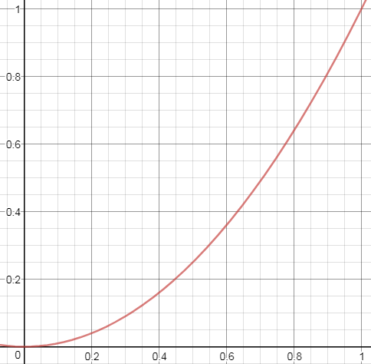

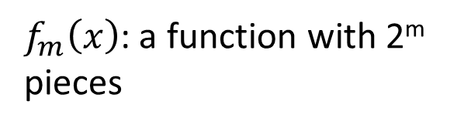
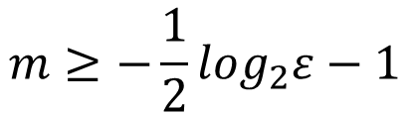


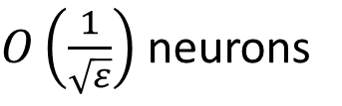

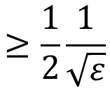
f(x) = x²
Fit the function by equally spaced linear pieces
$f_{m}\left(x\right)$: a function with 2^{m} pieces
$$\max_{0≤x≤1}\left|f\left(x\right)−f_{m}\left(x\right)\right|≤ε$$
What is the minimum m?
$$m≥−\frac{1}{2}\log_{2}ε−1$$
$$≥\frac{1}{2}\frac{1}{\sqrt{ε}}$$
pieces
$$2^{m}$$
$$f_{1}\left(x\right)$$
$$f_{2}\left(x\right)$$
Shallow:
$O\left(\frac{1}{\sqrt{ε}}\right)$ neurons

Slide 32






f(x) = x²
$$1$$
-
$$f_{1}\left(x\right)$$
$$\frac{1}{4}$$
-
$$f_{2}\left(x\right)$$
$$f_{1}\left(x\right)$$
$$\frac{1}{16}$$
$$f_{2}\left(x\right)$$

Slide 33




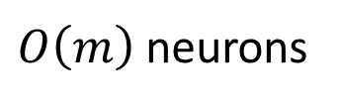

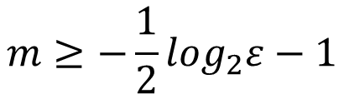
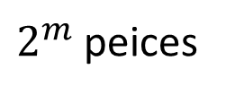


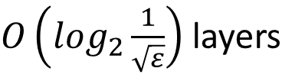





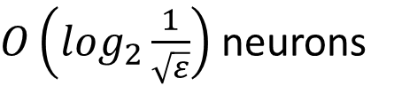



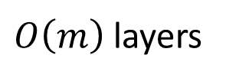
$$1$$
$$m≥−\frac{1}{2}\log_{2}ε−1$$
$$f_{m}\left(x\right)=$$
$O\left(m\right)$ neurons
$O\left(m\right)$ layers
$O\left(\log_{2}\frac{1}{\sqrt{ε}}\right)$ neurons
$O\left(\log_{2}\frac{1}{\sqrt{ε}}\right)$ layers
$2^{m}$ peices
$$−$$
$$−$$
$$−$$
$$……$$
$$−$$
$$\frac{1}{4}$$
$$\frac{1}{16}$$
$$\frac{1}{4^{m}}$$
……
2¹ lines
2² lines
2^{m} lines
$$x$$
+
$$a_{1}$$
+
$$a_{2}$$
$$…$$
+
$$a_{m}$$
1
1
1

Slide 34



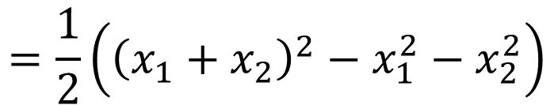

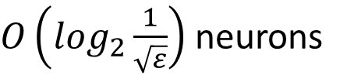



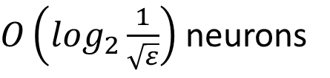




Why care about $y=x^{2}$?
$O\left(\log_{2}\frac{1}{\sqrt{ε}}\right)$ neurons
$$y=x_{1}x_{2}$$
Square
Net
$$=\frac{1}{2}\left({\left(x_{1}+x_{2}\right)}^{2}−x_{1}^{2}−x_{2}^{2}\right)$$
$$x$$
$$x^{2}$$
$$≤ε$$
$$x_{1}$$
Square
Net
$$×−0.5$$
Square
Net
$$×−0.5$$
$$x_{2}$$
+
$$x_{1}x_{2}$$
+
Square
Net
$$×0.5$$
$O\left(\log_{2}\frac{1}{\sqrt{ε}}\right)$ neurons
Multiply Net
Notes:
要一直考慮誤差

Slide 35

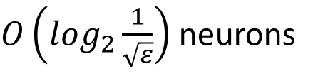


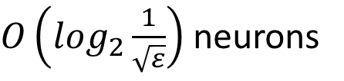






Polynomial
$O\left(\log_{2}\frac{1}{\sqrt{ε}}\right)$ neurons
$$y=x^{n}$$
Power(n) Net
Square
Net
Multiply
Net
Multiply
Net
……
$$x$$
$$x^{2}$$
$$x^{3}$$
$$y=a_{n}x^{n}+a_{n−1}x^{n−1}+⋯+a_{0}$$
$O\left(\log_{2}\frac{1}{\sqrt{ε}}\right)$ neurons
Power(n) Net
$$×a_{n}$$
Power(n-1) Net
$$×a_{n−1}$$
$$x$$
+
$$y$$
…
Use polynomial function to fit other functions.
Notes:
. power. 「指數」中的次方是power

Slide 36
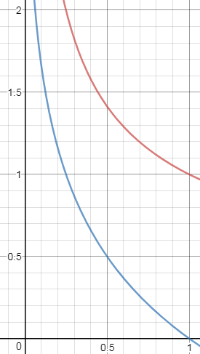
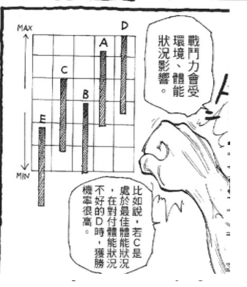
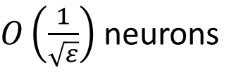
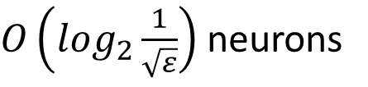
Deep v.s. Shallow
Shallow
This is not sufficient to show the power of deep.
$O\left(\frac{1}{\sqrt{ε}}\right)$ neurons
Shallow 很糟的狀態?
Deep
$O\left(\log_{2}\frac{1}{\sqrt{ε}}\right)$ neurons
Shallow 的最佳狀態???
(獵人第二十卷)

Slide 37
Is Deep better than Shallow?

Slide 38
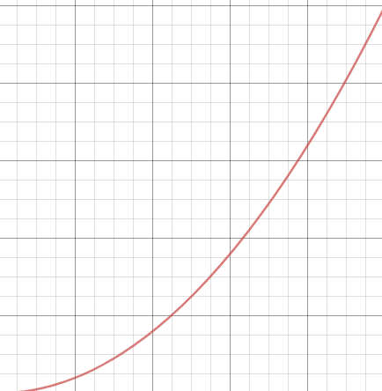
Best of Shallow
$\max_{0≤x≤1}\left|{f\left(x\right)−f}^{∗}\left(x\right)\right|≤ε$
$\sqrt{\int_{0}^{1}{{\left|{f\left(x\right)−f}^{∗}\left(x\right)\right|}^{2}}dx}{≤ε}$
Use Euclidean
A relu network is a piecewise linear function.
Using the least pieces to fit the target function.
可達成
夢幻狀態
Not continuous
Smaller error
The lines do not have to connect the end points.

Slide 39



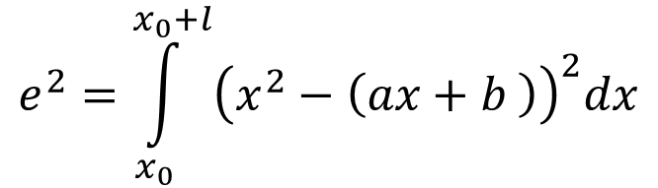


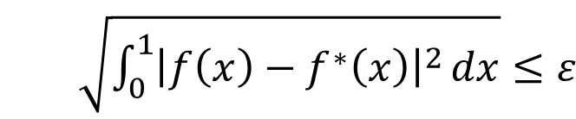
Best of Shallow
$\sqrt{\int_{0}^{1}{{\left|{f\left(x\right)−f}^{∗}\left(x\right)\right|}^{2}}dx}{≤ε}$
Use Euclidean
Given a piece, what is the smallest error
$$e^{2}=\int_{x_{0}}^{x_{0}+l}{{\left(x^{2}−\left(ax+b \right)\right)}^{2}dx}$$
$$ax+b$$
Find a and b to minimize e²
$$\frac{l^{5}}{180}$$
The minimum value of e² is
$$l$$
$$x_{0}$$
$$x_{0}+l$$

Slide 40
Warning of Math

Slide 41





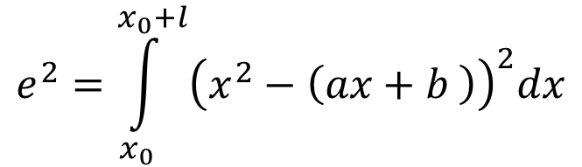






Intuition
$$e^{2}=\int_{x_{0}}^{x_{0}+l}{{\left(x^{2}−\left(ax+b \right)\right)}^{2}dx}$$
$$f_{v}=x^{2}$$
$$f_{w}=x$$
$$f_{u}=1$$
Minimize
Minimize
$${\left\|\overset{⃑}{v}−\left(a\overset{⃑}{w}+b\overset{⃑}{u}\right)\right\|}^{2}$$
$${\left\|f_{v}−\left(af_{w}+bf_{u}\right)\right\|}^{2}$$
$$\overset{⃑}{v}$$
$$f_{v}$$
$$\overset{⃑}{w}$$
$$a\overset{⃑}{w}+b\overset{⃑}{u}$$
$$af_{w}+bf_{u}$$
$$\overset{⃑}{u}$$

Slide 42
End of Warning

Slide 43

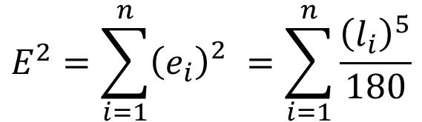







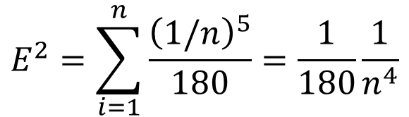




Best of Shallow
$$\frac{l^{5}}{180}$$
The minimum value of e² is
If you have n pieces, what is the best way to arrange the n pieces.
$$\sum_{i=1}^{n}{l_{i}}=1$$
$$l_{1}$$
$$l_{2}$$
$$l_{3}$$
$$……$$
$$l_{n}$$
0
$${\left(e_{1}\right)}_{}^{2}$$
$${\left(e_{2}\right)}_{}^{2}$$
$${\left(e_{3}\right)}_{}^{2}$$
$${\left(e_{n}\right)}_{}^{2}$$
1
$$E^{2}=\sum_{i=1}^{n}{{\left(e_{i}\right)}_{}^{2}}=\sum_{i=1}^{n}{\frac{{\left(l_{i}\right)}^{5}}{180}}$$
The best way is “equal segment”
$$E^{2}=\sum_{i=1}^{n}{\frac{{\left(1/n\right)}^{5}}{180}}=\frac{1}{180}\frac{1}{n^{4}}$$
$$l_{i}=1/n$$

Slide 44
Warning of Math

Slide 45


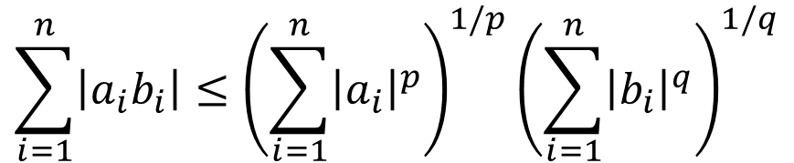











Hölder's inequality
$$\sum_{i=1}^{n}{l_{i}}=1$$
Minimize $\sum_{i=1}^{n}{{\left(l_{i}\right)}^{5}}$
Given $\left\{a_{1},a_{2},⋯,a_{n}\right\}$ and $\left\{b_{1},b_{2},⋯,b_{n}\right\}$
Given $\left\{l_{1},l_{2},⋯,l_{n}\right\}$ and $\left\{1,1,⋯,1\right\}$
$$\sum_{i=1}^{n}{\left|a_{i}b_{i}\right|}≤{\left(\sum_{i=1}^{n}{{\left|a_{i}\right|}^{p}}\right)}^{1/p}{\left(\sum_{i=1}^{n}{{\left|b_{i}\right|}^{q}}\right)}^{1/q}$$
$$\frac{1}{p}+\frac{1}{q}=1$$
$$1+\frac{p}{q}=p$$
$$1−p=−\frac{p}{q}$$
$$n^{−1/q}≤{\left(\sum_{i=1}^{n}{{l_{i}}^{p}}\right)}^{1/p}$$
$$\sum_{i=1}^{n}{l_{i}}≤{\left(\sum_{i=1}^{n}{{l_{i}}^{p}}\right)}^{1/p}{\left(\sum_{i=1}^{n}{1^{q}}\right)}^{1/q}$$
$$1−p$$
p=5
$$n^{−p/q}≤\sum_{i=1}^{n}{{l_{i}}^{p}}$$
$$n^{−4}≤\sum_{i=1}^{n}{{l_{i}}^{5}}$$
$$=1$$
$$=n$$

Slide 46
End of Warning

Slide 47







Best of Shallow
$$\frac{l^{5}}{180}$$
The minimum value of e² is
If you have n pieces, what is the best way to arrange the n pieces.
$$E=\sqrt{\frac{1}{180}}\frac{1}{n^{2}}$$
$$E^{2}=\frac{1}{180}\frac{1}{n^{4}}$$
To make $E≤ε$, what is the n we need?
$$E=\sqrt{\frac{1}{180}}\frac{1}{n^{2}}≤ε$$
$$n^{2}≥\sqrt{\frac{1}{180}}\frac{1}{ε}$$
$$n≥\sqrt[4]{\frac{1}{180}}\sqrt{\frac{1}{ε}}$$
At least $O\left(\frac{1}{\sqrt{ε}}\right)$ neurons

Slide 48
Deep v.s. Shallow
Shallow
Deep is exponentially better than shallow.
$O\left(\frac{1}{\sqrt{ε}}\right)$ neurons
Shallow 最佳狀態
Shallow 很糟的狀態?
Deep
$O\left(\log_{2}\frac{1}{\sqrt{ε}}\right)$ neurons
Shallow 的最佳狀態???
(獵人第二十卷)

Slide 49
More related theories

Slide 50


More Theories
A function expressible by a 3-layer feedforward network cannot be approximated by 2-layer network.
Unless the width of 2-layer network is VERY large
Applied on activation functions beyond relu
The width of 3-layer network is K.
The width of 2-layer network should be $Ae^{BK^{4/19}}$.
Ronen Eldan, Ohad Shamir, “The Power of Depth for Feedforward Neural Networks”, COLT, 2016
Notes:
W = Kd^(19/4) d^(19/4) = W/K d = W/K ^(4/19)
Ae^{Bd} = A e ^ {B (W/K) ^(4/19) } = A e ^ {B/K’ (W) ^(4/19) }

Slide 51



More Theories
A function expressible by a deep feedforward network cannot be approximated by a shallow network.
Unless the width of the shallow network is VERY large
Applied on activation functions beyond relu
Deep Network:
$Θ\left(k^{3}\right)$ layers, $Θ\left(1\right)$ nodes per layer, $Θ\left(1\right)$ distinct parameters
Shallow Network:
$Θ\left(k\right)$ layers
$Ω\left(2^{k}\right)$ nodes
Matus Telgarsky, “Benefits of depth in neural networks”, COLT, 2016

Slide 52

Itay Safran, Ohad Shamir, “Depth-Width Tradeoffs in Approximating Natural Functions with Neural Networks”, ICML, 2017
0
1

Slide 53


More Theories
Dmitry Yarotsky, “Error bounds for approximations with deep ReLU networks”, arXiv, 2016
Dmitry Yarotsky, “Optimal approximation of continuous functions by very deep ReLU networks”, arXiv 2018
Shiyu Liang, R. Srikant, “Why Deep Neural Networks for Function Approximation?”, ICLR, 2017
Itay Safran, Ohad Shamir, “Depth-Width Tradeoffs in Approximating Natural Functions with Neural Networks”, ICML, 2017
If a function f has “certain degree of complexity”
Approximating f to accuracy $ε$ in the L2 norm using a fixed depth ReLU network requires at least $poly\left(1/ε\right)$
There exist a ReLU network of depth and width at most $poly\left(log\left(1/ε\right)\right)$ that can achieve the approximation.

Slide 54
The Nature of Functions
Hrushikesh Mhaskar, Qianli Liao, Tomaso Poggio, When and Why Are Deep Networks Better Than Shallow Ones?, AAAI, 2017

